Slide 1
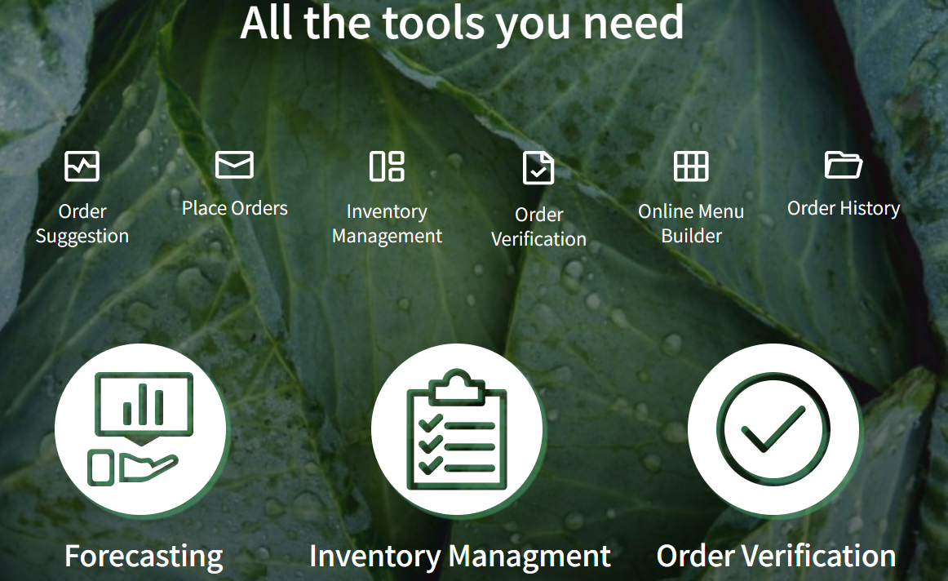
Is this still the plan? What is next?

Slide 2

Greenbytes App : Firebase and Cloud Functions
Cloud Functions can handle events in Cloud Firestore in the same Cloud project as the function. You can read and/or update Cloud Firestore in response to these events using the Firestore APIs and client libraries.
In a typical lifecycle, a Cloud Firestore function does the following:
Waits for changes to a particular document.
Triggers when an event occurs and performs its tasks.
Receives a data object with a snapshot of the affected document. For write or update events, the data object contains snapshots representing document state before and after the triggering event.

Slide 3












GCP, Firebase and Services on Managed VMs
Architecture: General > Firebase and Managed VMs
Runs Your Service in Docker Containers
App Engine
Docker
Kubernetes Engine
iOS
Process the Data
Update Data
Firebase
Synchronize Across Devices
Android
MachineLearning
Real-Time
Prediction API
Web

Slide 4






Current APIs and tools used to extract data from POS
POS API tools, RESTful API
Developers sources such as https://developer.fourth.com/en-gb/docs/recipe-menu-engineering-export-api/guide

Slide 5
Transition to generic integration with POS; parameterize variables by passing on identifiers (to get data)
List all potential POS/APIs from Iceland and other countries
In order to transition from particular (hard coded) to general, determine standard fields required POS for data extracts such as:
Potentially built in a query builder form with firestore data with parameters
Link API example for dk : GET /api/v1/product/transaction/{page}/{count}*
Tokens and Identifiers
Fields:
ID /Name
Date
Quantity sold

Slide 6
Create screen for visual feedback on savings and impact for app users (already wireframed)

